Slide 1
Team 3 - Week 4 Update
Scott Birss
David Caplin
Troy Fine
Gabriel Ji
Aditya Sriwasth
Nelson Yeap

Slide 2
Accomplishments this week and Upcoming Goals:
This week
Finalized Design
Hardware Parts List
Software State Diagrams
Created an initial Document
Finalized the Gantt Chart
Schedule of tasks for the quarter
Next week
APIs for Bluetooth Beacon to Phone, Pi to Pi communications via WIFI and Camera to Pi interface
Basic functionality of sensor and start spec sheets

Slide 3
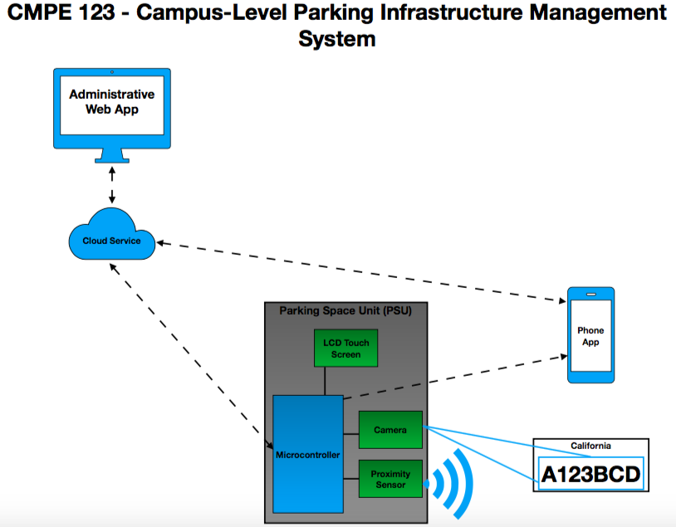

Slide 4
Hardware: High level Overview
Display
Display
Proximity Sensor
Proximity Sensor
Parking space
PSoC
Bluetooth Beacon
PSoC
Parking space
Raspberry Pi
Bluetooth Beacon
smartphone
Camera
smartphone
Camera
5V Power

Slide 5
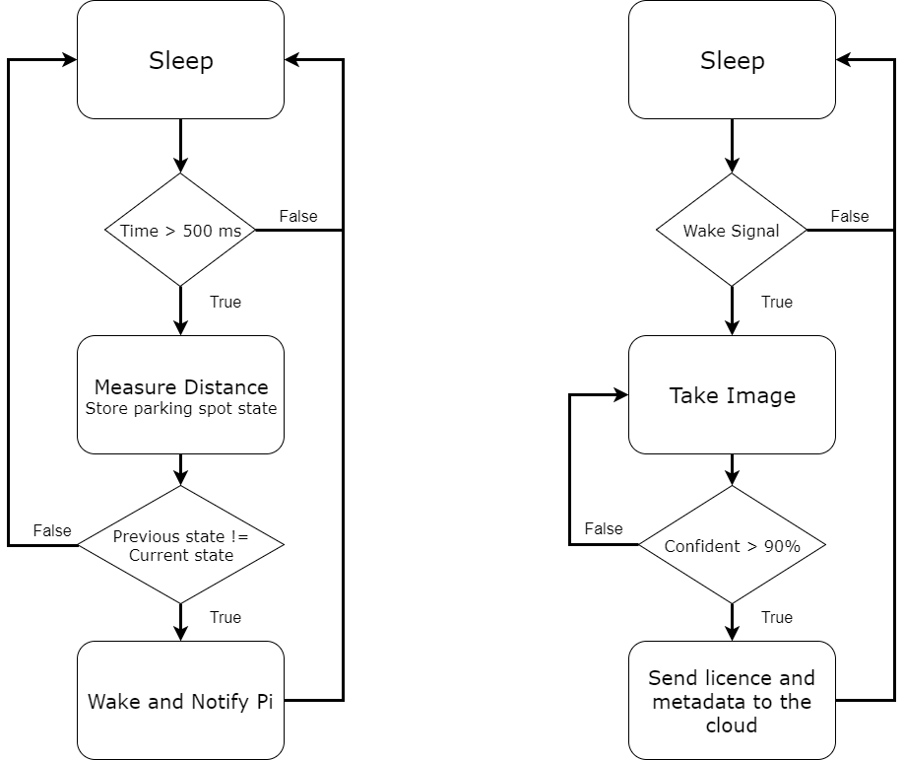
PSoC State Diagram
Pi State Diagram

Slide 6
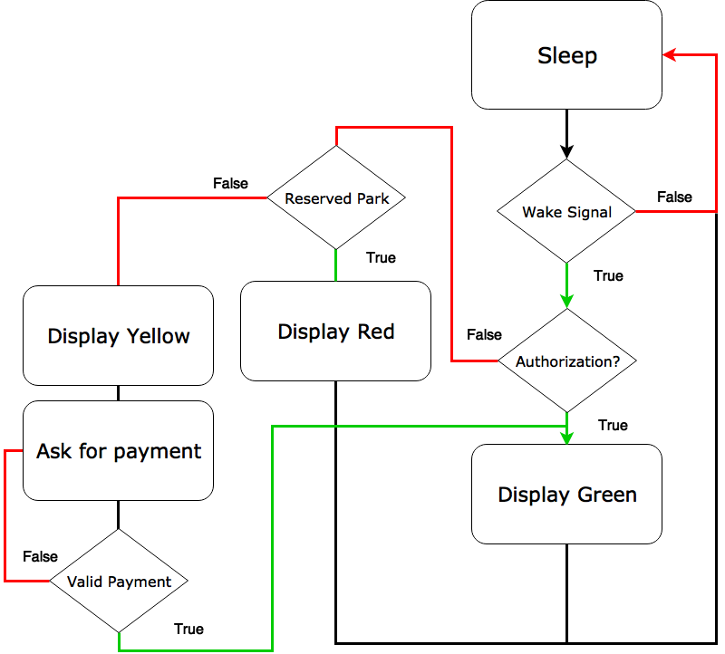
Display Diagram

Slide 7
Hardware Concerns
Raspberry Pi does not have a sleep state.

Slide 8
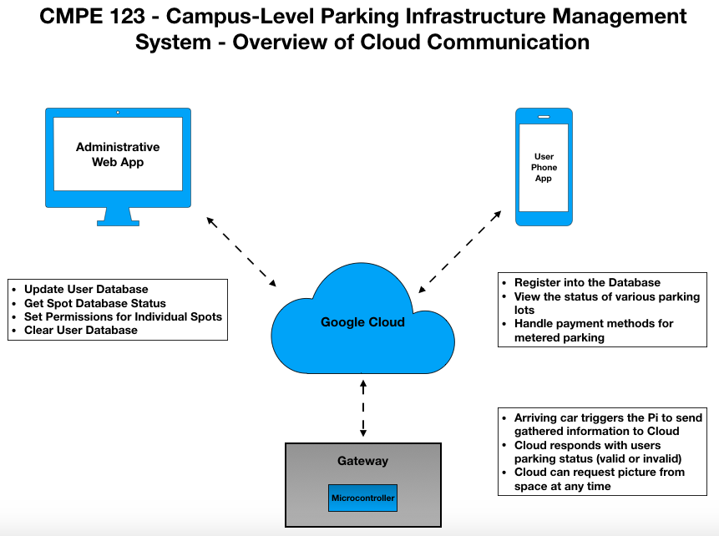

Slide 9
Google Cloudstore Update
Created an account on the Google Cloud Platform
Installed Python, pip, virtualenv and git
Created and ran my first Python test program
Covered all the communication that will be exchanged between the Raspberry Pi and the Cloud

Slide 10
Web and mobile application update
Installed Apache Cordova and began research on how to use it.
Created a basic skeletal app with embedded images and managed to execute it and run it on Chrome and Firefox.
For the mobile application, Google Cloud Endpoints is what we plan on using in order to generate API’s and client libraries.
Android has several REST API’s that work with Google (specifically json), so we plan to build a basic app on Android Studio first
Then utilize the same protocols and integrate it on Apache Cordova
This week we will continue research and development on the web application and try to begin working on linking it up with the cloud as soon as possible.

Slide 11
Planned procedure for the Mobile App
The first time a user opens the app
Enter Student ID (if currently enrolled at UCSC)
If not, use as guest
Choose a parking lot structure to view spots
Choose between North, West, East Remote
Send a push notification once pulled into a parking spot
If the user is a registered student with a parking permit, do not charge
Else, if the user is a registered student without a parking permit, add charge to UCSC account
Else, the user is a guest, ask them to enter payment (Apple/Android Pay or Credit Card)
Potential additional features
Let the user reserve a spot temporarily for 2-5 minutes

Slide 12
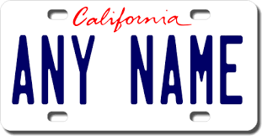
Raspberry & Computer Vision
Got the DVI to HDMI adapter to set up the Raspberry Pi in the Lab
Working on setting up the computer vision library on the Pi
Wake up signal
Raspberry Pi
(Computer Vision)
ANY NAME
Cloud

